Slide 1
Algorithm Analysis & Asymptotic
Guda Pranay Netha

Slide 2
Algorithm Analysis
It is important to be able to measure, or at least make educated statements about, the space and time complexity of an algorithm. This will allow you to compare the merits of two alternative approaches to a problem you need to solve Measuring Time

Slide 3
Measuring Time
The absolute running time of an algorithm cannot be predicted, since this depends on the
Programming Language used to implement the algorithm,
The computer the program runs in
Other programs running at the same time
The Quality of Operating System
Many Other Factors

Slide 4
T(n)~ Relative Run Time
It is Not possible the run time in Sec or Milli sec as the run time is heavily depended on the underlying Hardware and Software
So to Generalize the Runtime of an Algorithm universally acceptable we use T(n)
T(n)– Algorithms Relative Running Time, as a function of how many items there are in the input
The Number of Items in a Container
The Length of a String or File

Slide 5
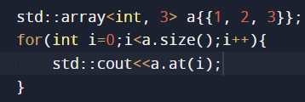
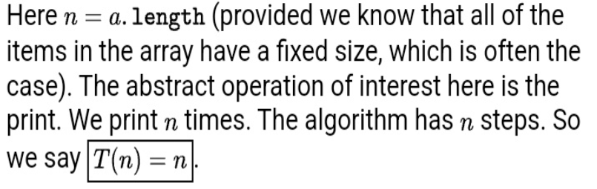
Example-Printing Elements of Array

Slide 6
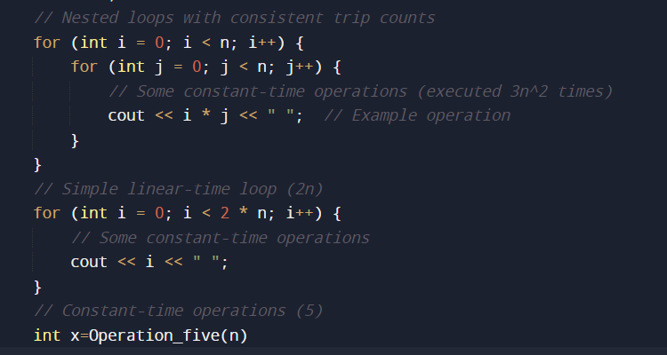
Another Example T(n)=3n*2+2n+5

Slide 7
Example
Purpose: Locate a specific page in a book.
Approach: Open the book to the middle. Check if the target page is before or after the middle page. Repeat the process by opening the relevant half of the book at its middle.
Time complexity: T(n) = log2(n), where n is the total number of pages. On average, it takes log2(n) page openings to find the target page.

Slide 8
BigOh!!!!!!! Notation(O(n)
T(n): Represents the exact running time of an algorithm as a function of the input size (n). It captures the precise number of operations performed for a given input.
O(n): Represents the asymptotic upper bound of the running time, focusing on its growth rate as n becomes large. It describes the algorithm's behavior for very large inputs, simplifying comparison and avoiding constant factors and lower-order terms that become less significant as n grows.

Slide 9
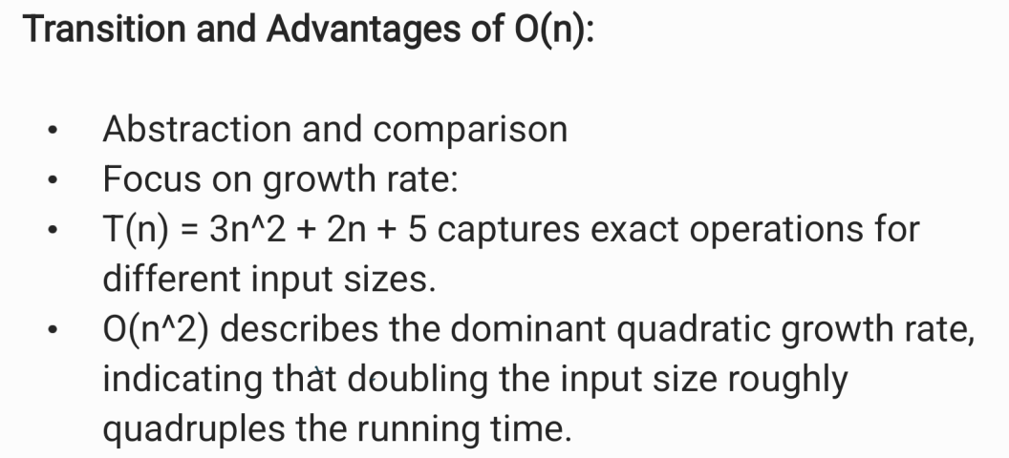

Slide 10
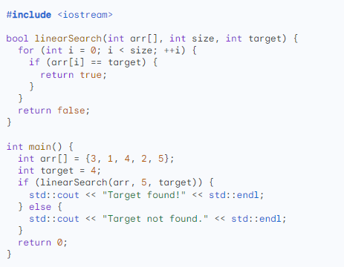
Example Program

Slide 11
Big O Notation (O-notation)
Meaning: Big O tells you the upper bound of an algorithm's running time, essentially the worst-case scenario. It describes how the time taken by the algorithm grows asymptotically (i.e., for very large inputs)
Think of it as: An upper limit on how bad things can get. Even if the algorithm usually runs faster, Big O guarantees that it won't exceed a certain order of growth for large enough inputs.

Slide 12
Theta Notation (Θ-notation):
Meaning: Theta notation captures the exact growth rate of an algorithm, encompassing both the upper and lower bounds. It tells you how tightly the actual running time is bound to a specific order of growth
Think of it as: The sweet spot where the best-case, worst-case, and average-case scenarios all coincide in terms of growth rate.

Slide 13
Omega Notation (Ω-notation):
Meaning: Omega notation defines the lower bound of an algorithm's running time, essentially the best-case scenario. It tells you how much time the algorithm must take at least, regardless of the input.
Think of it as: A guaranteed minimum threshold for how fast things can be. Even if the algorithm sometimes takes longer, Omega notation assures you that it won't be slower than a certain order of growth for large enough inputs.

Slide 14
Focus on Worst-Case Scenario:
Big O prioritizes the upper bound of an algorithm's running time, essentially the worst-case scenario. This is crucial for performance guarantees, especially in critical systems where even occasional hiccups can be unacceptable.

Slide 15
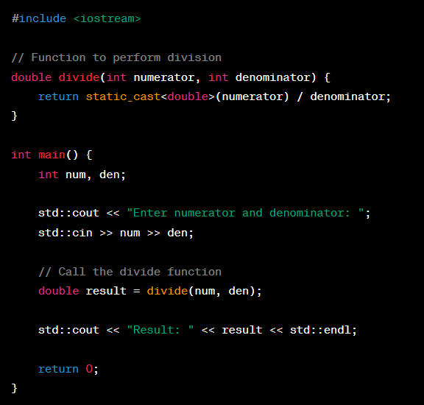
Exceptions in C++
In C++, exceptions are a mechanism used for handling errors and exceptional conditions in a program.

Slide 16
What is The Problem??
Abrupt Termination Of The Program
Bad User Experience
Unkown Reason for the Termination

Slide 17
Try & Catch Block
Try{
// Try out Something
//If("error"){
throw std::error_type("Message ")
}
}
Catch(const logic_error& e){
std::cerr << "Exception caught: " << e.what() << std::endl;
}

Slide 18
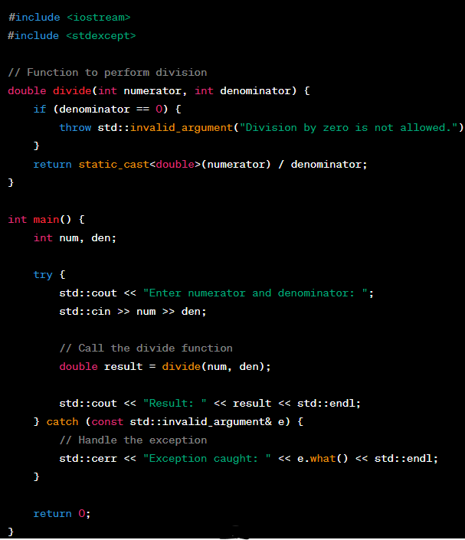
Implementation using Try Catch in C++

